Slide 1
Cubic Hermite Interpolations of Signed Distance Fields
Viktor Vad, Gábor Valasek
WSCG 2025
Pilsen, 26 - 29 May 2025
Notes:
I would like to talk about our investigations about how much it is possible to represent SDFs with cubic hermitte polynomials.

Slide 2
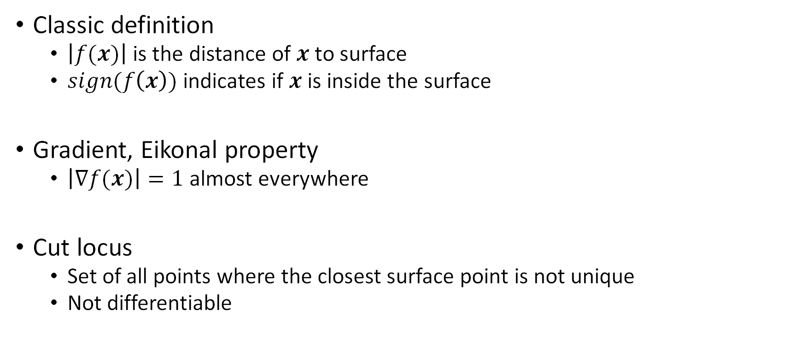
Signed Distance Functions
Classic definition
$\left|f(x)\right|$ is the distance of $x$ to surface
$sign(f\left(x\right))$ indicates if $x$ is inside the surface
Gradient, Eikonal property
$\left|∇f(x)\right|=1$ almost everywhere
Cut locus
Set of all points where the closest surface point is not unique
Not differentiable
Notes:
Signed Distance Function, is an implicit surface representation, where the absolute value of the functions corresponds to the distance to the surface, and the sign indicates insideness.

Slide 3
Signed Distance Functions
Discretization
Mostly used in real-time graphics
Values are stored in discrete points (e.g on grid)
On GPU: Texture memory, highly cached, efficient memory bandwidth
Continuous reconstruction is applied to discrete samples

Slide 4
Why 2D?
Ease of reproduction
Ease of implementation for different methods
Enough to prove our point
Can be extended to any (particularly 3D) dimensions

Slide 5
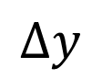
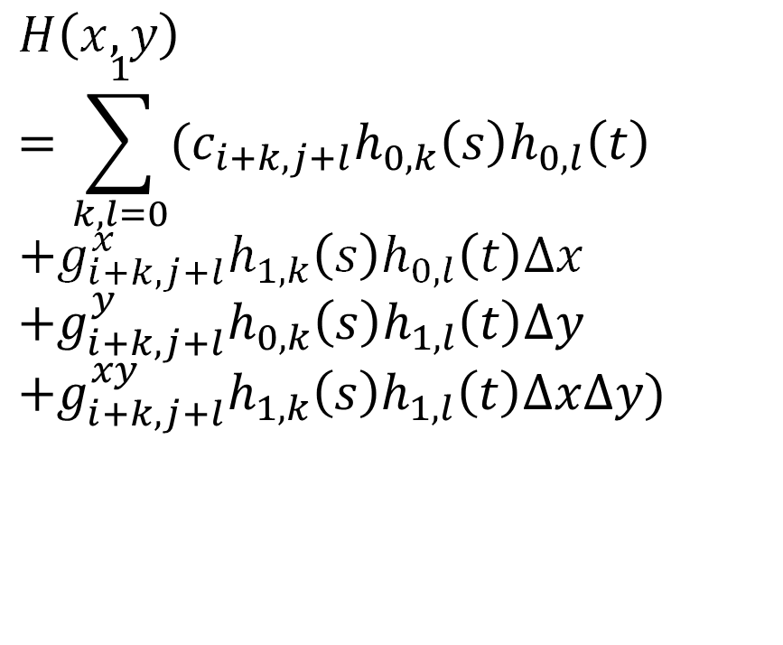
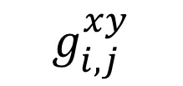
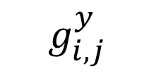
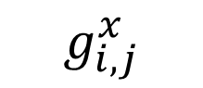
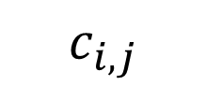
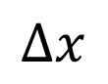
Cubic Hermite-based reconstruction
$$∆x$$
$$H\left(x,y\right)=\sum_{k,l=0}^{1}{(c_{i+k,j+l}h_{0,k}\left(s\right)h_{0,l}\left(t\right)} \\ +g_{i+k,j+l}^{x}h_{1,k}\left(s\right)h_{0,l}\left(t\right)∆x \\ +g_{i+k,j+l}^{y}h_{0,k}\left(s\right)h_{1,l}\left(t\right)∆y \\ +g_{i+k,j+l}^{xy}h_{1,k}\left(s\right)h_{1,l}\left(t\right)∆x∆y)$$
$$∆y$$
$$g_{i,j}^{y}$$
$$g_{i,j}^{xy}$$
$$c_{i,j}$$
$$g_{i,j}^{x}$$
Notes:
This formulation makes it tempting to use well defined SDF gradient values.

Slide 6
Catmull-Rom
Estimating derivatives by central difference
Efficient evaluation schemes

Slide 7
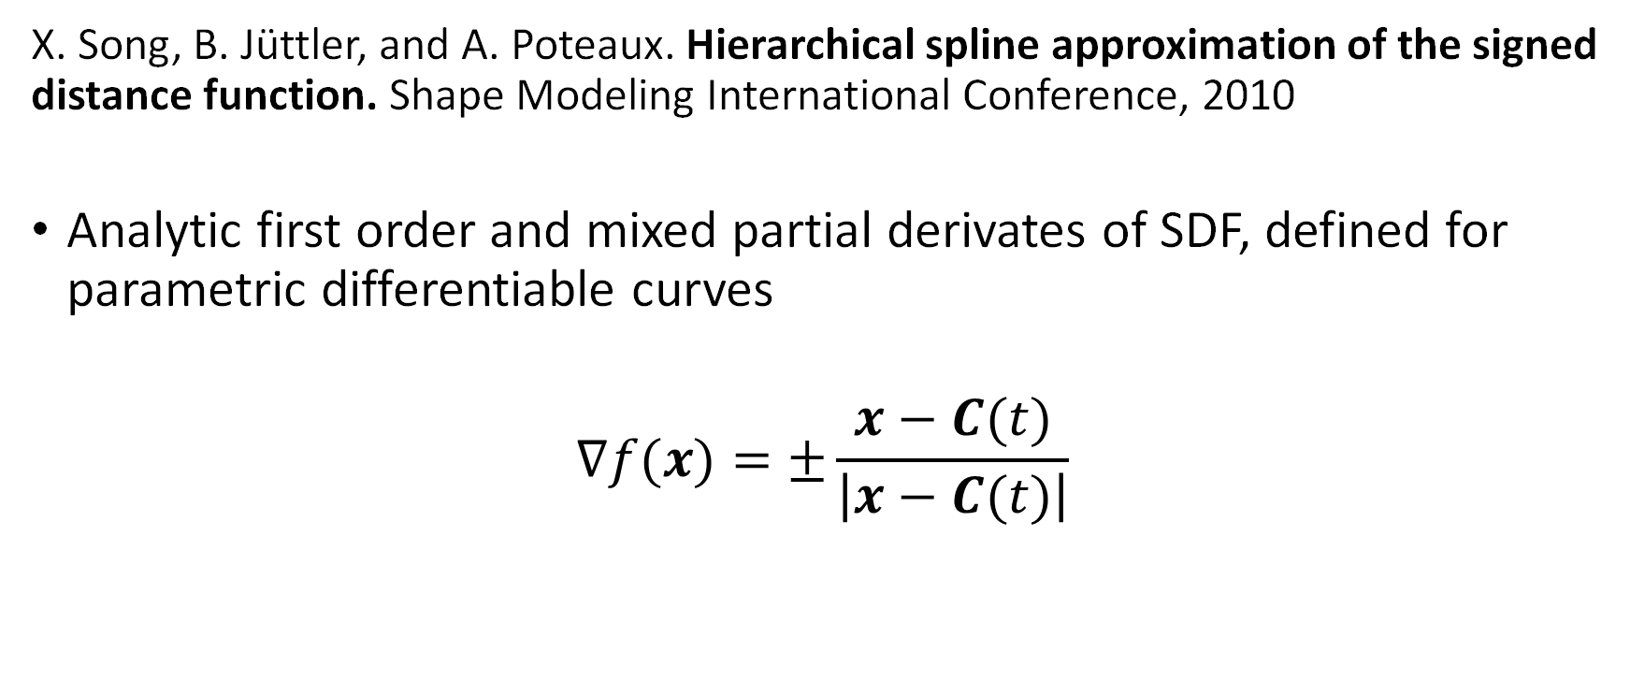
Analytic derivatives
X. Song, B. Jüttler, and A. Poteaux. Hierarchical spline approximation of the signed distance function. Shape Modeling International Conference, 2010
Analytic first order and mixed partial derivates of SDF, defined for parametric differentiable curves
$$∇f(x)=±\frac{x−C(t)}{\left|x−C(t)\right|}$$
Closest point on curve
Numerical issues close to the curve
Querry point

Slide 8
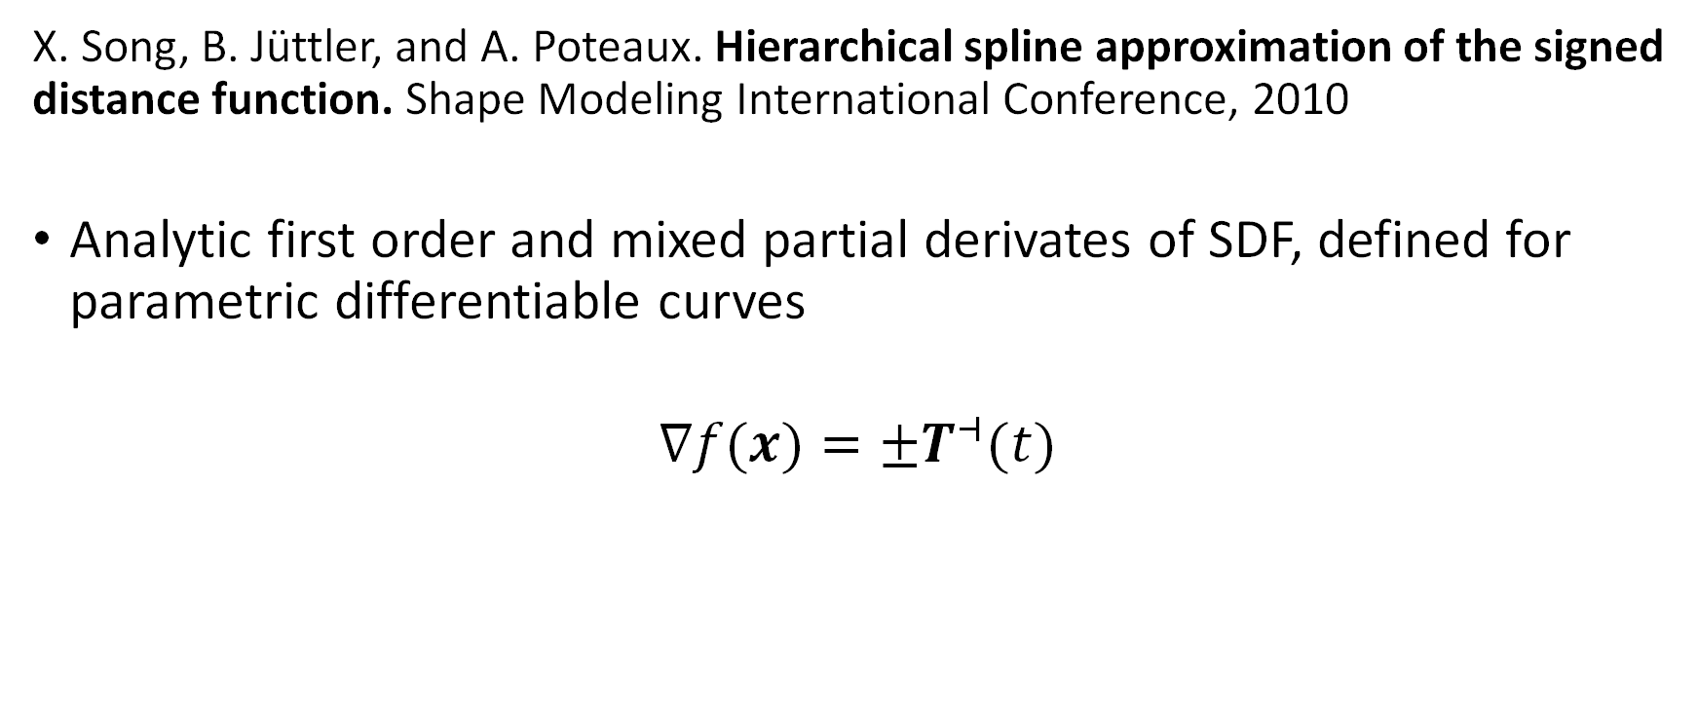
Analytic derivatives
X. Song, B. Jüttler, and A. Poteaux. Hierarchical spline approximation of the signed distance function. Shape Modeling International Conference, 2010
Analytic first order and mixed partial derivates of SDF, defined for parametric differentiable curves
$$∇f(x)=±T^{⊣}(t)$$
Unit tangent
at closest point on curve,
rotated by 90°
Hot fix:
Query point

Slide 9
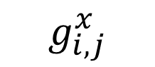
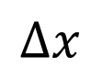
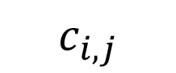
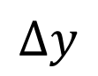
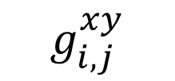
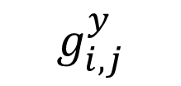
Ferguson patch
Gábor Valasek and Róbert Bán. Higher Order Algebraic Signed Distance Fields. Computer-Aided Design and Applications, 2023
$$∆x$$
$$∆y$$
$$g_{i,j}^{y}$$
$$g_{i,j}^{xy}$$
$$c_{i,j}$$
$$g_{i,j}^{x}$$

Slide 10
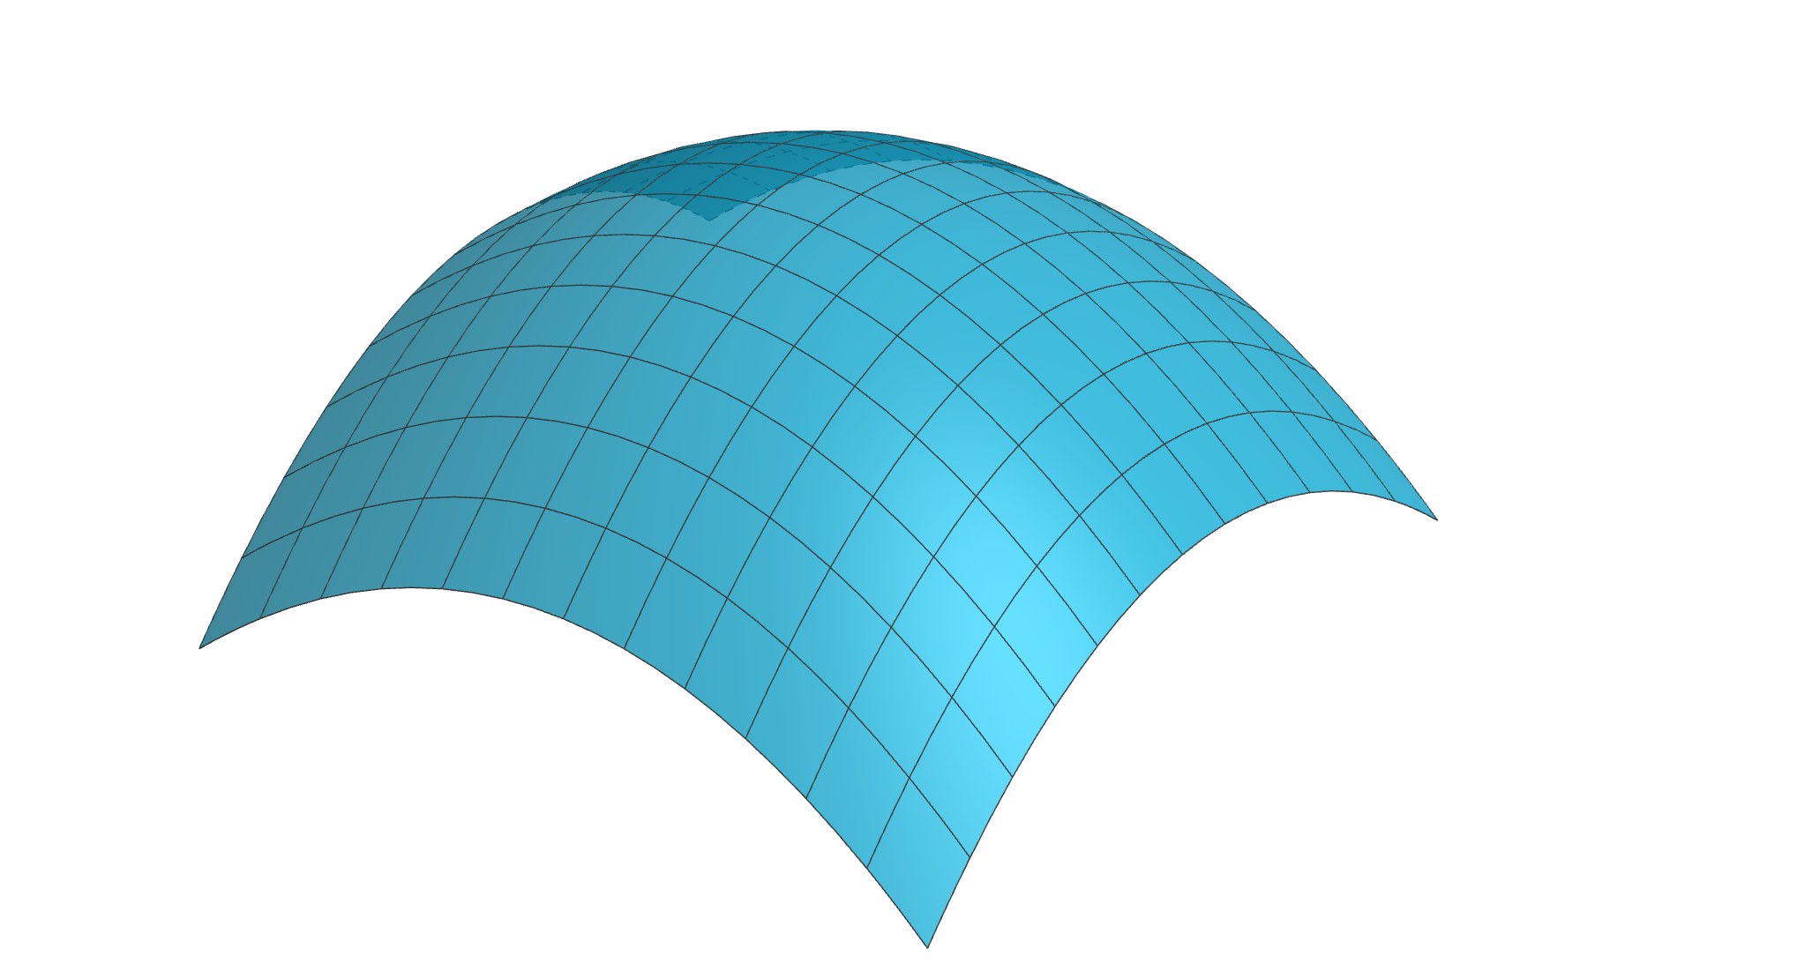
Hermite Algebraic Derivates
Gábor Valasek and Róbert Bán. Higher Order Algebraic Signed Distance Fields. Computer-Aided Design and Applications, 2023
$$∆x$$
Local algebraic surface on dual grid
Analytic mixed partial
derivative of local
surface
$$∆y$$
$$g_{i,j}^{y}$$
$$g_{i,j}^{xy}$$
Using this as
mixed partial
derivative
$$c_{i,j}$$
$$g_{i,j}^{x}$$
Notes:
Surrogate models

Slide 11
Adini-twist
Róbert Bán and Gábor Valasek. Hermite interpolation of scalar fields in computer graphics. Computer-Aided Design and Applications, 2025
$$∆x$$
Coons-patch from 2x2 grid edge curves
Estimated mixed
partial derivative in
closed form
$$∆y$$
$$g_{i,j}^{y}$$
$$g_{i,j}^{xy}$$
$$c_{i,j}$$
$$g_{i,j}^{x}$$

Slide 12
Motivation
Cubic Hermite is polynomial interpolation, ...
... but polynomial form cannot be unit speed!
How well do we preserve the SDF properties after reconstruction?

Slide 13
Least-squares fitting
$$∆x$$
Used as a reference
No assumptions to derivative coeficients
Solving 3 smaller problem (instead of one big system)
$$∆y$$
$$g_{i,j}^{y}$$
$$g_{i,j}^{xy}$$
$$c_{i,j}$$
$$g_{i,j}^{x}$$
Notes:
Contribution of mixed partial derivatives

Slide 14
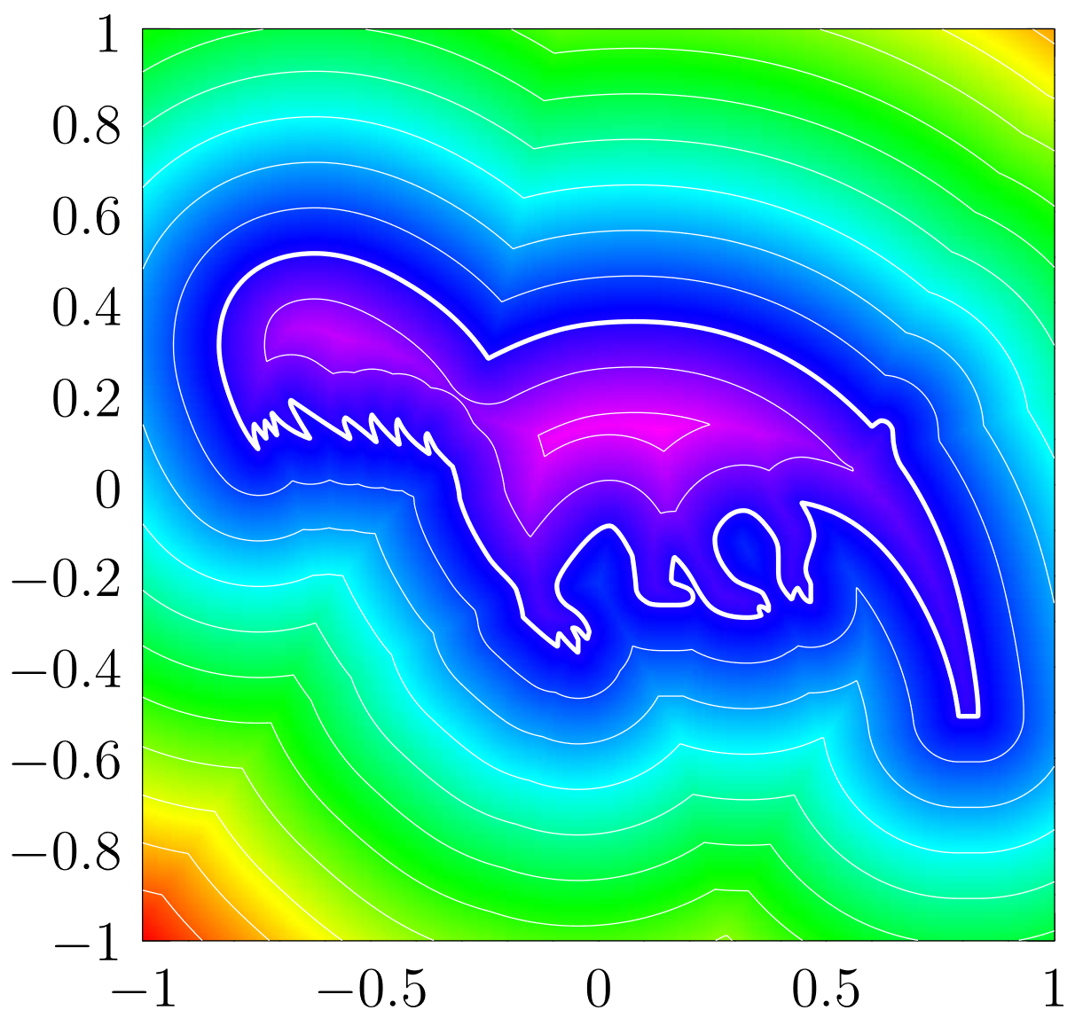
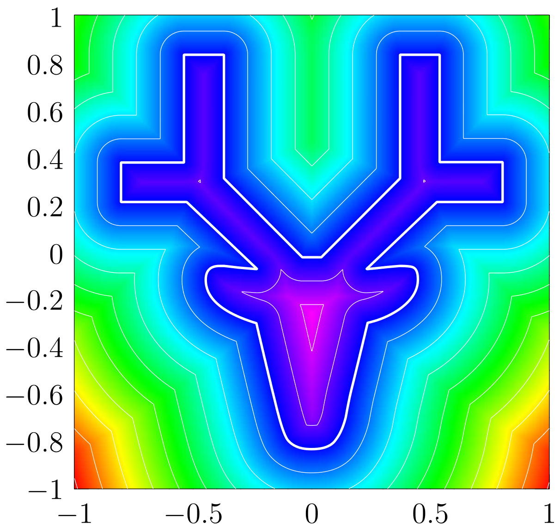
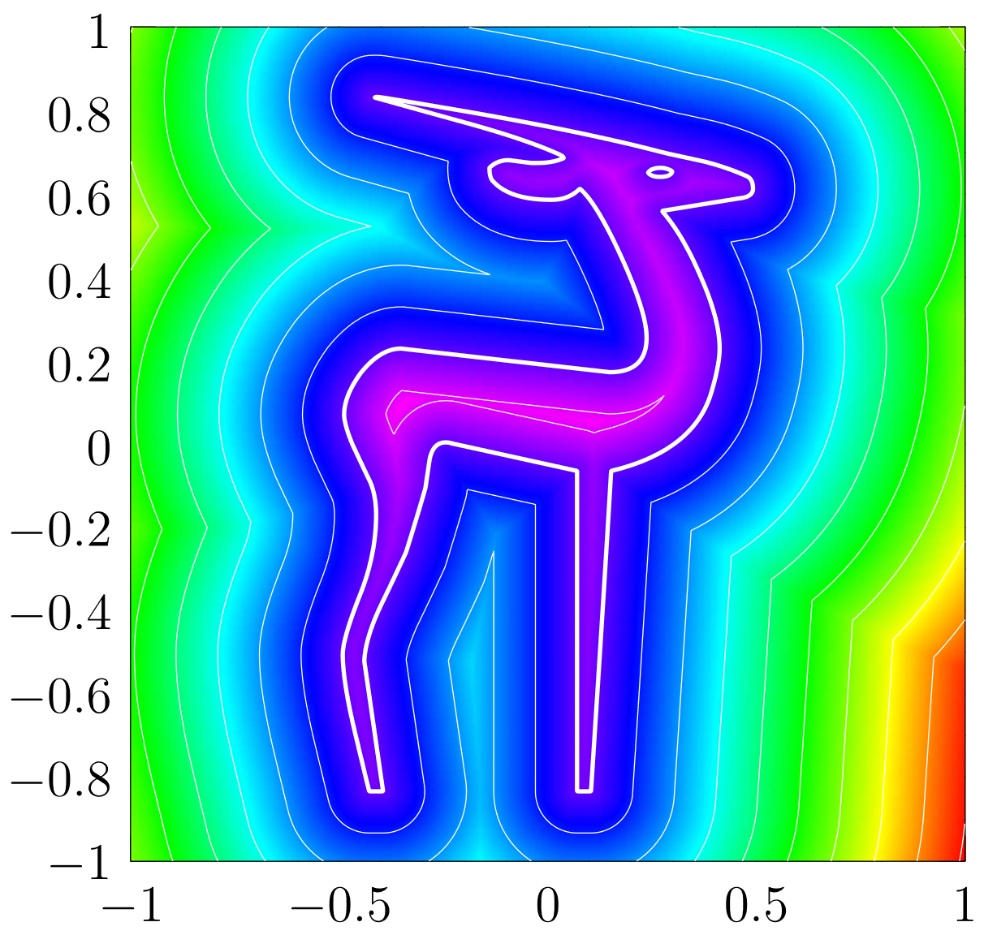
Test Dataset
FreeType Fonts (https://www.fontrepo.com/font/17449/wmanimals2)
Bezier curves (linear and quadratic), many hundreds
Scaled to same domain

Slide 15
Error metrics
RMS
Measures function reconstruction quality
Intersection over Union
Measures shape reconstruction quality
Used in image processing
Gradient Length (from unit) and Angle deviation
Measures SDF reconstruction quality, including Eikonal property
Closest point energy
Zoë Marschner, Silvia Sellán, Hsueh-Ti Derek Liu, and Alec Jacobson. Constructive solid geometry on neural signed distance fields. SIGGRAPH Asia 2023
Combines the gradient and angle error

Slide 16
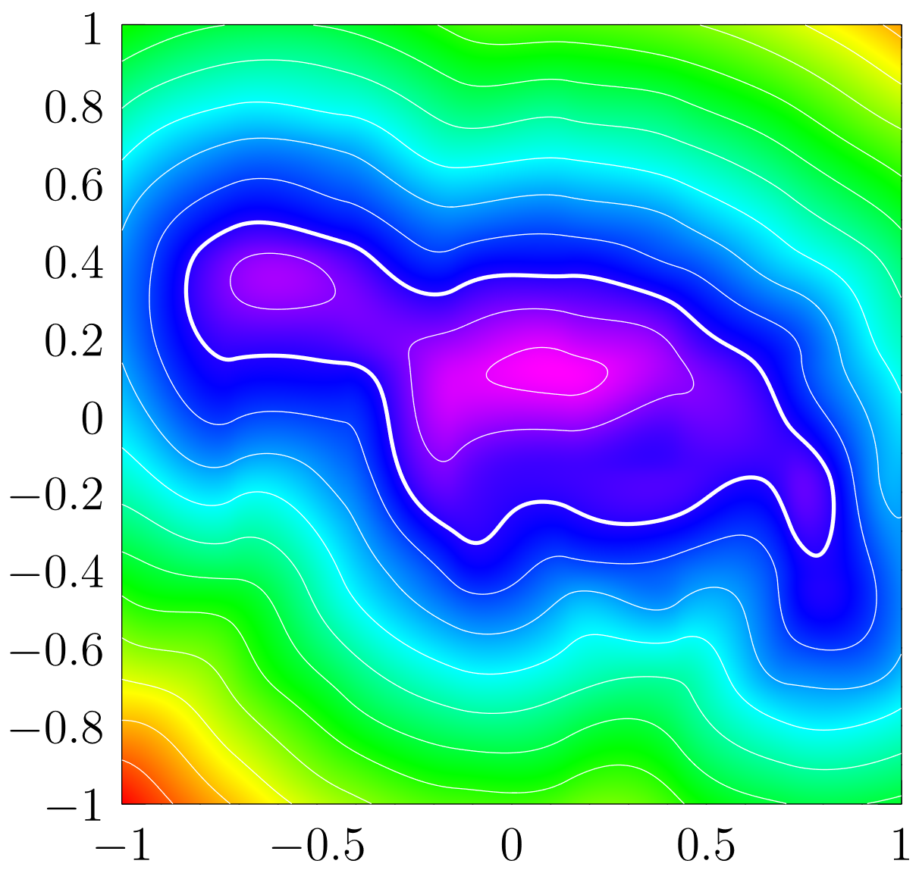


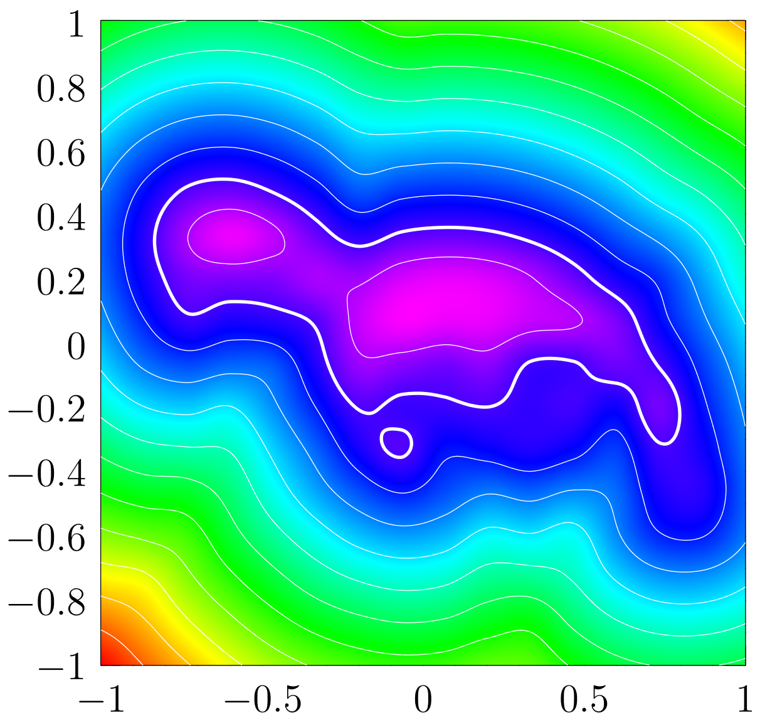

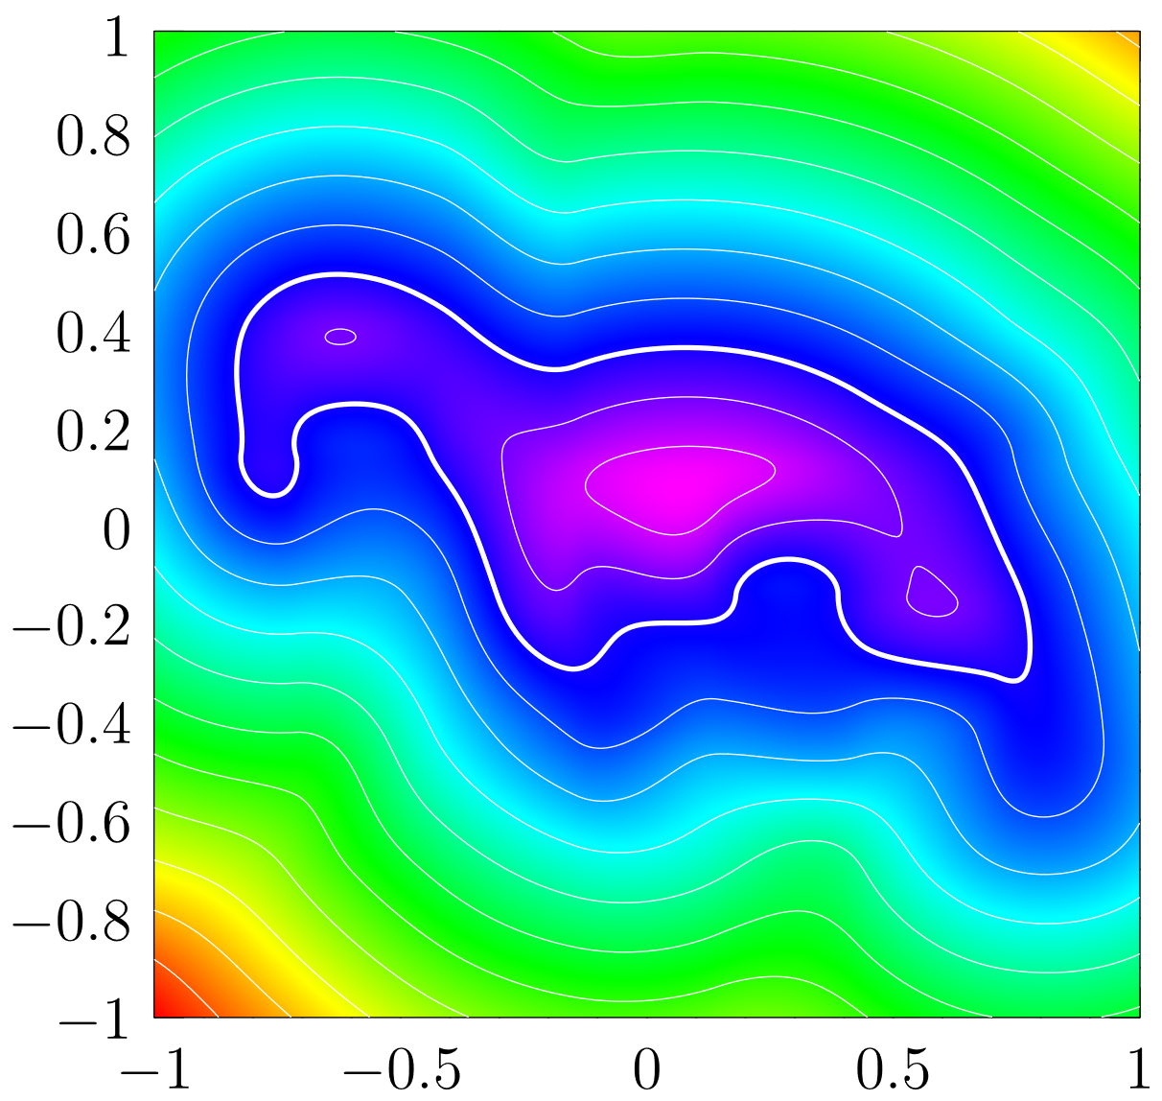
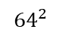
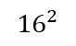
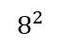
Results
$$8^{2}$$
$${16}^{2}$$
$${64}^{2}$$
LSQ
Catmull-Rom
Analytic derivatives
SDF sampled on progressively finer grids
Reconstructed with each methods
Error measured with each metric
Notes:
We sampled the analytic SDF at progressively finer
grid resolutions and reconstructed the SDF using each
method. Then, we applied each metric at every resolution.
LSQ: best results
C.R: worst results
Analytic: naivly one could expect best results

Slide 17
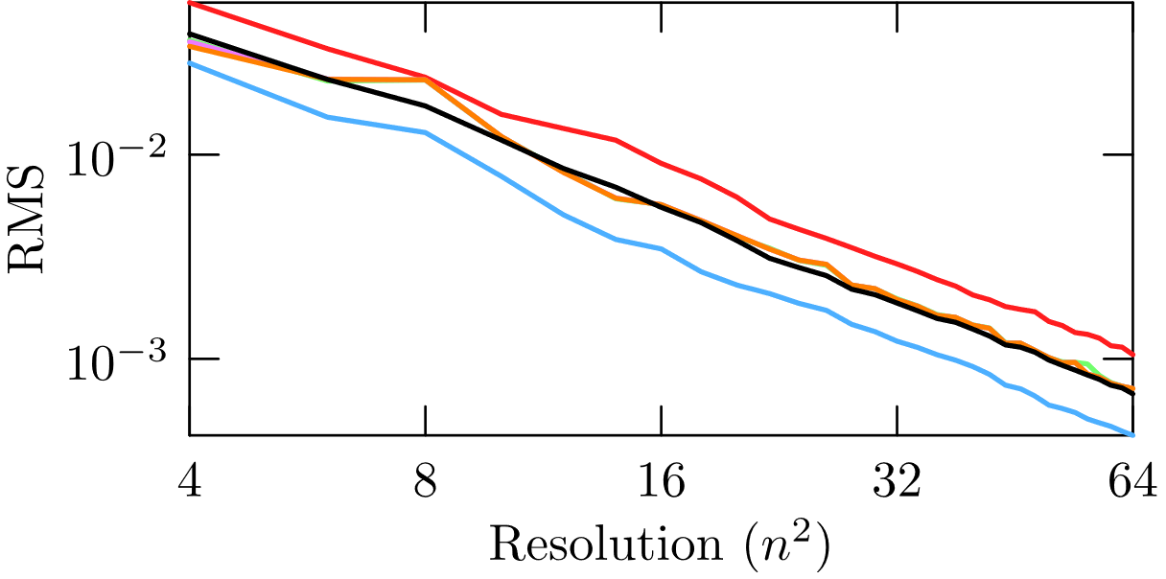
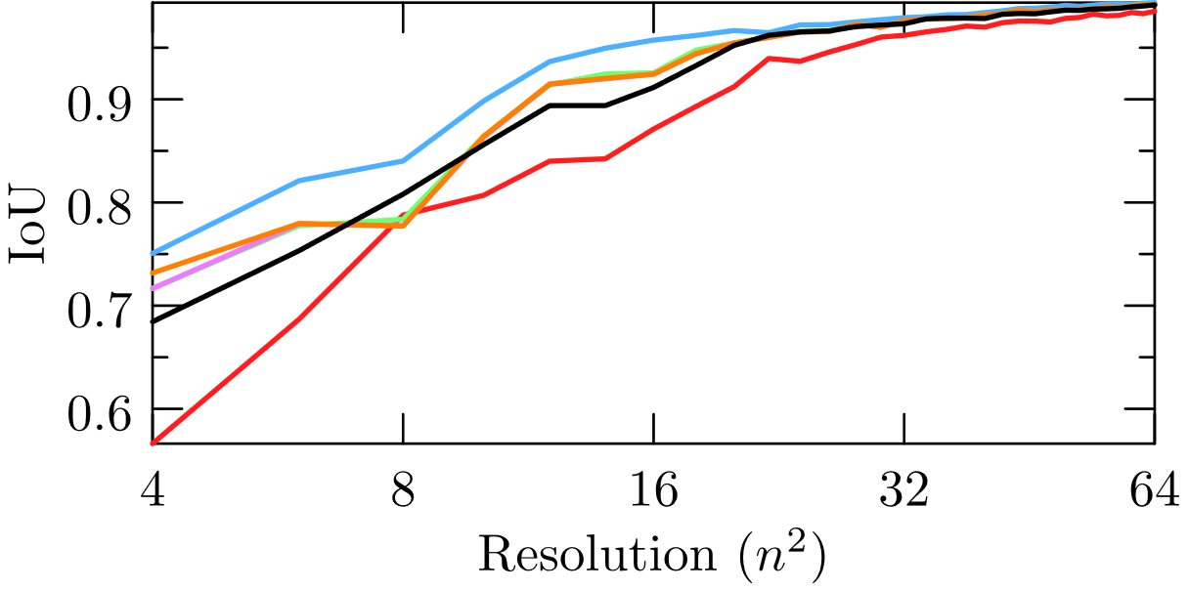
Results (RMS/IoU)
 |  | Catmull-Rom | LSQ | Analytic derivatives | Fergusson | Adini-twist | HAD
RMS | 4 | 0.066 | 0.037 | 0.051 | 0.052 | 0.052 | 0.053
 | 8 | 0.027 | 0.010 | 0.018 | 0.018 | 0.018 | 0.017
 | 16 | 0.009 | 0.004 | 0.006 | 0.006 | 0.006 | 0.006
 | 32 | 0.003 | 0.001 | 0.002 | 0.002 | 0.002 | 0.002
 | 64 | 0.001 | 0.000 | 0.001 | 0.001 | 0.001 | 0.001
IoU | 4 | 0.296 | 0.468 | 0.472 | 0.474 | 0.460 | 0.303
 | 8 | 0.516 | 0.807 | 0.721 | 0.718 | 0.720 | 0.680
 | 16 | 0.757 | 0.926 | 0.895 | 0.895 | 0.895 | 0.850
 | 32 | 0.920 | 0.969 | 0.962 | 0.962 | 0.962 | 0.951
 | 64 | 0.981 | 0.990 | 0.995 | 0.995 | 0.995 | 0.992

Slide 18
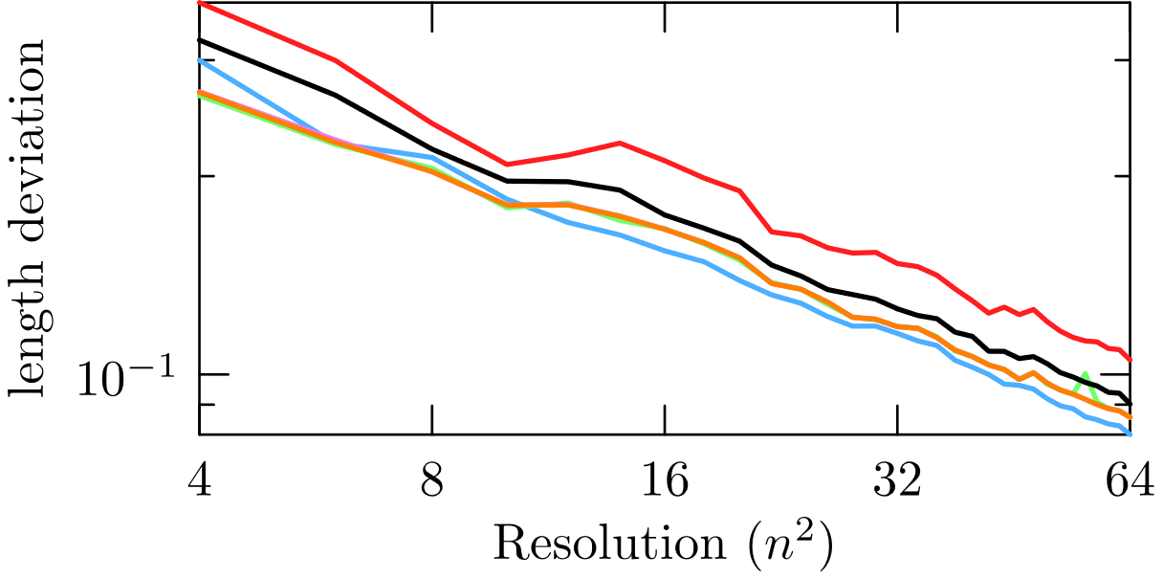
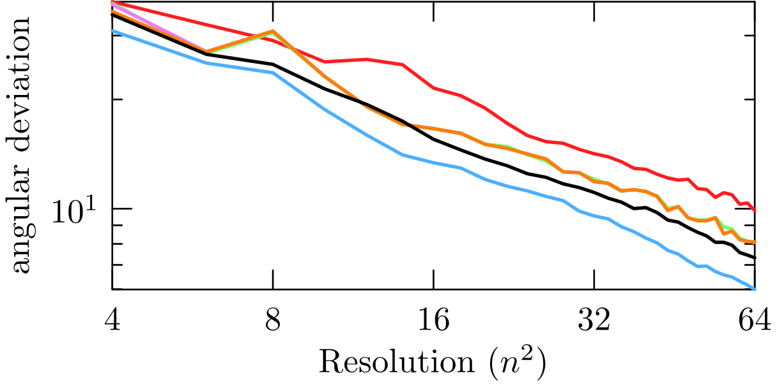
Results (Length and Angular deviation)
 |  | Catmull-Rom | LSQ | Analytic derivatives | Fergusson | Adini-twist | HAD
Length dev. | 4 | 0.421 | 0.413 | 0.396 | 0.399 | 0.394 | 0.445
 | 8 | 0.325 | 0.258 | 0.266 | 0.266 | 0.265 | 0.288
 | 16 | 0.253 | 0.190 | 0.196 | 0.198 | 0.197 | 0.218
 | 32 | 0.180 | 0.138 | 0.142 | 0.142 | 0.142 | 0.154
 | 64 | 0.127 | 0.097 | 0.099 | 0.099 | 0.099 | 0.107
Angular dev. | 4 | 62.576 | 36.459 | 41.168 | 41.972 | 40.931 | 55.161
 | 8 | 34.999 | 19.238 | 26.099 | 26.156 | 26.118 | 25.064
 | 16 | 23.813 | 12.482 | 16.941 | 17.057 | 17.034 | 16.632
 | 32 | 15.721 | 7.499 | 11.239 | 11.257 | 11.254 | 10.096
 | 64 | 9.771 | 5.078 | 7.599 | 7.602 | 7.601 | 6.555
Notes:
Length-deviation stays ~10%

Slide 19
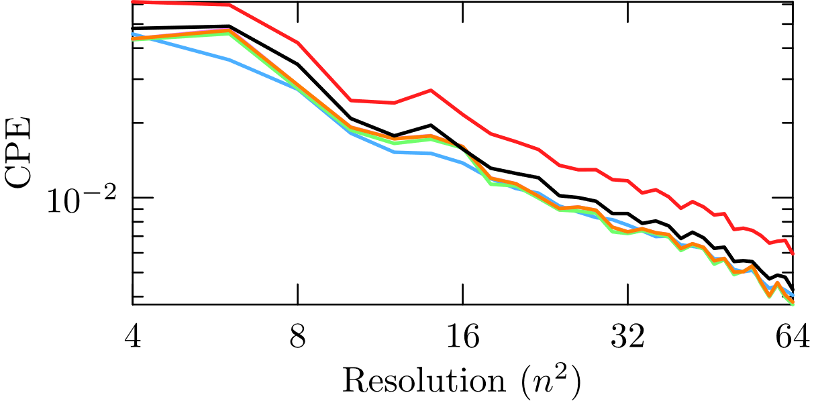
Results (Closest point energy)
 |  | Catmull-Rom | LSQ | Analytic derivatives | Fergusson | Adini-twist | HAD
CPE | 4 | 0.061 | 0.046 | 0.043 | 0.044 | 0.044 | 0.048
 | 8 | 0.042 | 0.027 | 0.028 | 0.028 | 0.028 | 0.034
 | 16 | 0.022 | 0.014 | 0.016 | 0.016 | 0.016 | 0.016
 | 32 | 0.012 | 0.008 | 0.007 | 0.007 | 0.007 | 0.009
 | 64 | 0.006 | 0.004 | 0.004 | 0.004 | 0.004 | 0.004
Notes:
Not that definite

Slide 20
Conclusion
Investigated the applicability of Hermite interpolation for reconstructing Signed Distance Functions
Error metrics for function and shape characteristic
Special metrics for SDF properties
SDF related errors were always significant
Generally, LSQ obtained best results.
Takeaway: polynomial approximation of SDFs needs extra care
Notes:
Based on our results, while Hermite interpolation can
approximate the SDF values accurately, it does not preserve
the key SDF properties, such as unit-length gradients,
gradient directions, or CPE to the same degree.

